Slide 1
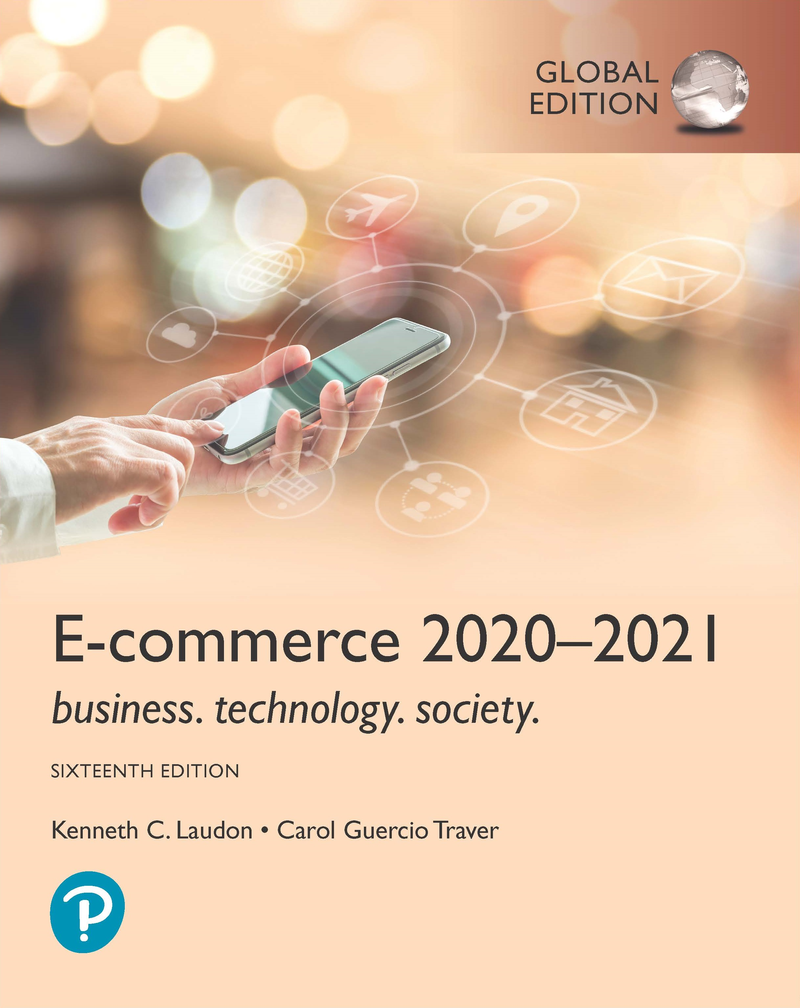
E-commerce 2020-2021: Business. Technology. Society.
Sixteenth Edition, Global Edition
Chapter 2
E-commerce Infrastructure
Slides in this presentation contain hyperlinks. JAWS users should be able to get a list of links by using INSERT+F7
Copyright © 2021 Pearson Education Ltd. All Rights Reserved
Notes:
If this PowerPoint presentation contains mathematical equations, you may need to check that your computer has the following installed:
1) MathType Plugin
2) Math Player (free versions available)
3) NVDA Reader (free versions available)

Slide 2
Learning Objectives
2.1 Discuss the origins of, and the key technology concepts behind, the Internet.
2.2 Explain the current structure of the Internet.
2.3 Understand how the Web works.
2.4 Describe how Internet and web features and services support e-commerce.
2.5 Understand the impact of mobile applications.
Notes:
Slide 2 is list of textbook LO numbers and statements

Slide 3
Tech Titans Target a Prize: Bringing Internet Access to Rural India
Class Discussion
How can the business opportunities of rural India be assessed?
What is rural India’s biggest potential?
Which of the various methods described for bringing the Internet to rural India do you feel might be most successful?
Notes:
As to the future, Amazon, SpaceX, OneWeb, scs, intelsat, Boeing, ViaSat, Telesat, Audacy, Karousel LLC, Space Norway, Theia Holdings, and LeoSat are all hoping to establish networks of low and medium earth orbit satellites to provide Internet access.
Facebook’s Project Athena, White Space technolgoy

Slide 4
The Internet: Technology Background
Internet
Interconnected network of thousands of networks and millions of computers
Links businesses, educational institutions, government agencies, and individuals
World Wide Web (Web)
One of the Internet’s most popular services
Provides access to billions, possibly trillions, of web pages

Slide 5
The Evolution of the Internet 1961–Present
Innovation Phase, 1961–1974
Creation of fundamental building blocks.
Packet switching hardware, TCP/IP, and Client/Server computing were conceptualized and implemented.
Institutionalization Phase, 1975–1995
Large institutions(DoD, NSF) provide funding and legitimization.
Commercialization Phase, 1995–present
Private corporations take over, expand Internet backbone and local service
Notes:
1961 the concept of package switching was born
1962 global computer network was born
1969 the concept of packet switched the network moves closer towards physical reality.
1969 the first packet switched messages sent on our planet from UCLA to Stanford
1972 e-mail is invented by ray Tomlinson the first killer app of the Internet is born
1973 client server computing was invented forming the Internet and local area networks
1974 open architecture networking and TCP/IP concepts are presented in the paper and hence TCP/IP was invented.
1976 apple one is released
1980 TCP/IP is officially adopted as the DoD standard communication protocol
1981 IBM introduces IBM PC it's first personal computer
1984 apple computer releases HyperCard programme as parts of it's graphical user interface operating system called Macintosh. The concept of hyperlink the documents and records that permit the user to jump from one page or record to another is commercially introduced.

Slide 6
The Internet: Key Technology Concepts
Internet defined as network that:
Uses I P addressing
Supports T C P/I P
Provides services to users, in manner similar to telephone system
Three important concepts:
Packet switching
T C P/I P communications protocol
Client/server computing

Slide 7
Packet Switching
Slices digital messages into packets
Sends packets along different communication paths as they become available
Reassembles packets once they arrive at destination
Uses routers
Less expensive, wasteful than circuit-switching

Slide 8
Figure 2.3 Packet Switching
Notes:
Figure 2.3, Page 121.
In packet switching, digital messages are divided into fixed-length packets of bits (generally about 1,500 bytes). Header information indicates both the origin and the ultimate destination address of the packet, the size of the message, and the number of packets the receiving node should expect. Because the receipt of each packet is acknowledged by the receiving computer, for a considerable amount of time, the network is not passing information, only acknowledgments, producing a delay called latency.
Full description: A figure illustrates the process involved in packet switching. The process is as follows. Original text message, I want to communicate with you. Text message digitized into bits, which is in the form of a series of zeroes and ones. Digital bits broken into packets, each packet containing eight bits. Header information added to each packet indicating destination, and other control information, such as how many bits are in the total message and how many packets. The header information is shown in the form of three groups of zeroes and ones, eight bits in each group.

Slide 9
T C P/I P
Transmission Control Protocol (T C P)
Establishes connections among sending and receiving Web computers
Handles assembly of packets at point of transmission, and reassembly at receiving end
Internet Protocol (I P)
Provides the Internet addressing scheme and is responsible for delivery of packets
Four T C P/I P layers
Network interface layer - placing packets on and receiving them from the network medium.
Internet layer - addressing, packaging, and routing messages on the Internet
Transport layer - providing communication with other protocols within tcp/ip suite
Application layer - includes protocols used to provide user services or exchange data
Notes:
N/W interface Layer: Responsible for placing packets on and receiving them from the network medium.
Internet Layer: Responsible for addressing, packaging, and routing messages on the Internet
Transport layer: Responsible for providing communication with other protocols within tcp/ip suite
Application layer: Includes protocols used to provide user services or exchange data

Slide 10
Figure 2.4 The T C P/I P Architecture and Protocol Suite
Notes:
Figure 2.4, Page 123.
TCP/IP is an industry-standard suite of protocols for large internetworks. The purpose of TCP/IP is to provide high-speed communication network links.
Full description: A flow diagram shows T C P and I P architecture and protocol suite. The diagram has two parts. On the left, the T C P and I P Protocol Architecture Layers are shown, and on the right, the T C P and I P Protocol Suite lists the protocols within each layer. The layers and the corresponding protocols are as follows. Application Layer, which has H T T P, Telnet, F T P, S M T P, and B G P. Host-to-Host Transport Layer, which has T C P. Internet Layer, which has I P. And Network Interface Layer, which has Ethernet, Token Ring, Frame Relay, and A T M.

Slide 11
Internet (I P) Addresses
I P v4
32-bit number
Four sets of numbers marked off by periods: 201.61.186.227
Class C address: Network identified by first three sets, computer identified by last set
I P v6
128-bit addresses, able to handle up to 1 quadrillion addresses (I P v4 can handle only 4 billion)
Notes:
According to a Akamai, in the United States, about 50% of Internet traffic now occurs over IPv6.
India leads the way globally with over 60% of Internet traffic converted to IPv6

Slide 12
Figure 2.5 Routing Internet Messages: T C P/I P and Packet Switching
Notes:
Figure 2.5, Page 124.
The Internet uses packet-switched networks and the TCP/IP communications protocol to send, route, and assemble messages. Messages are broken into packets, and packets from the same message can travel along different routes.
Full description: A flow diagram shows how Internet messages are routed using T C P and I P and packet switching. The diagram shows a sender and a recipient connected by many routers. The three stages in the process of sending and receiving messages are as follows. First, T C P and I P breaks data into packets when they leave the sender machine. Second, the packets travel from router to router over the Internet. And third, T C P and I P reassembles the packets into the original whole when it reaches the recipient machine.

Slide 13
Domain Names, D N S, and U R L s
Domain name
I P address expressed in natural language
Domain name system (D N S)
Allows numeric I P addresses to be expressed in natural language
Uniform resource locator (U R L)
Address used by Web browser to identify location of content on the Web
For example: http://www.azimuth-interactive.com/

Slide 14
Client/Server Computing
Powerful personal computers (clients) connected in network with one or more servers
Servers perform common functions for the clients
Storing files
Software applications
Access to printers, and so on

Slide 15
The Mobile Platform
Primary Internet access is now through tablets and smartphones
Tablets supplement P Cs for mobile situations
Over 160 million people in U . S. use Internet with tablets
Smartphones are a disruptive technology
New processors and operating systems
Over 3.3 billion worldwide access Internet with smartphones

Slide 16
The Internet “Cloud Computing” Model (1 of 2)
Firms and individuals obtain computing power and software over Internet
Three types of services
Infrastructure as a service (I a a S)
Software as a service (S a a S)
Platform as a service (P a a S)
Public, private, and hybrid clouds

Slide 17
The Internet “Cloud Computing” Model (2 of 2)
Drawbacks
Security risks
Shifts responsibility for storage and control to providers
Radically reduces costs of:
Building and operating websites
Infrastructure, I T support
Hardware, software

Slide 18
Other Internet Protocols and Utility Programs
Internet protocols
H T T P
E-mail: S M T P, P O P 3, I M A P
F T P, Telnet, S S L/T L S
Utility programs
Ping
Tracert
Notes:
IMAP:Internet message access protocol
Ping: Packet Internet groper
Tracert: it is one of several route tracing-utilities that allow you to follow the path of a message you send from your client to a remote computer on the Internet

Slide 19
Internet Infrastructure
Internet growth has boomed without disruption because of:
Client/server computing model
Hourglass, layered architecture
Network Technology Substrate
Transport Services and Representation Standards
Middleware Services
Applications

Slide 20
Figure 2.10 The Hourglass Model of the Internet
Notes:
Figure 2.10 Page 134.
The Internet can be characterized as an hourglass modular structure with a lower layer containing the bit-carrying infrastructure (including cables and switches) and an upper layer containing user applications such as e-mail and the Web. In the narrow waist are transportation protocols such as TCP/IP.
Full description: The hourglass model shows four layers. Two layers are above the narrow neck of the hourglass, and one layer is below it. The layers from the bottom to top are as follows. Layer 1, Network Technology Substrates. It includes the following options: Coaxial cable, Fiber optic, Wireless, Satellite, LANs, and D S L. Layer 2, Transport Services and Representation Standards, which includes the I P V 6 and I P V 4 and TCP protocols. Layer 3, Middleware Services includes Storage repositories, Security, Authentication slash Identity management, and File systems. Layer 4, Applications, includes Web browsers, E-mail clients, Media players, Image servers, and Remote login.

Slide 21
Figure 2.11 Internet Network Architecture
Today’s Internet has a multi-tiered open network architecture featuring multiple backbones, regional hubs, campus/corporate area networks, and local client computers.
Notes:
Figure 2.11, Page 135.
Today’s Internet has a multi-tiered open network architecture featuring multiple backbones, regional hubs, campus/corporate area networks, and local client computers.
Full description: A schematic diagram shows Internet network architecture with a backbone, regional hubs, domains and various clients. The network diagram shows a backbone connected to regional hubs (comprised of two regional hosts and I X Ps connected to each other). One regional host is connected to a domain n y u dot e d u by a T 1 line. The domain is connected to a campus network and offices through a T 1 line, each of which have a client IP address. It is also connected to P O P 3 mail and S M T P mail. Another regional host is connected to a domain local I S P. This domain is connected to a home system through a D S L/FIOS or cable line. The home system has a client I P address.

Slide 22
The Internet Backbone
Comprised of fiber-optic cable: hundreds of glass strands that use light to transmit data
Faster speeds and greater bandwidth
Thinner, lighter cables
Less interference
Better data security
Called as Tier 1 Internet Service Providers (Tier 1 I S P s) or transit I S P s
Numerous private networks physically connected to each other
Undersea fiber optics, satellite links
Notes:
Tier 1 I S P s: AT&T, CenturyLink, Cogent communications, GTT communications, NTT communications, Sprint ,Verizon , Zayo Group

Slide 23
Internet Exchange Points (I X P s)
Regional hubs where Tier 1 I S P s physically connect with one another and with regional Tier 2 I S P s.
Tier 2 I S P s provide Tier 3 I S P s with Internet access.
Originally called Network Access Points (N A P s) or Metropolitan Area Exchanges (M A E s).

Slide 24
Tier 3 Internet Service Providers
Retail providers
Lease Internet access to home owners, small businesses
Large providers: Comcast, Charter Spectrum, A T&T, Verizon, Altice (Optimum)
Smaller local providers
Services
Narrowband - is the traditional telephone modem connection now operating at 56.6 kpbs
Broadband – refers to any communication technology that permits clients to play streaming audio and video files at acceptable speeds.
Digital subscriber line (D S L) – is a telephone technology that provides highspeed access to through ordinary telephones.
Cable Internet
Satellite Internet
Notes:
T1 and T3 lines are international telephone standards for digital communication.
T1 lines offer guaranteed delivery at 1.54 Mbps, while T3 lines offer 45 Mbps.
T1 lines cost about $200-$300 per month and T3 lines about $2500-$6000 per month.
T1 lines can download a 10MB file in 52 seconds and T3 in 2 seconds.

Slide 25
Campus/Corporate Area Networks
Local area networks operating within single organization, such as N Y U or Microsoft Corporation
Lease Internet access directly from regional and national carriers

Slide 26
Mobile Internet Access
Two basic types of wireless Internet access:
Telephone-based (mobile phones, smartphones)
Computer network-based (wireless local area network-based)
Telephone-based wireless Internet access
Currently based on 3G and 4G technologies
5G will provide higher bandwidth with speeds reaching 10 G b p s or more

Slide 27
Wireless Local Area Network (W L A N) -Based Internet Access
Wi-Fi (various 802.11 standards)
10-100 metres/11 mbps-7gbps
High-speed, fixed broadband wireless L A N (W L A N)
Wireless access point (“hot spots”)
Limited range but inexpensive
WiMax
30 miles/50-70 mbps
Bluetooth
1-30 metres/1-3 mbps

Slide 28
Figure 2.13 Wi-Fi Networks
Notes:
Figure 2.13, page 143.
In a Wi-Fi network, wireless access points connect to the Internet using a land-based broadband connection. Clients, which could be desktops, laptops, tablet computers, or smartphones, connect to the access point using radio signals.
Full description: An image shows various connections to Wi-Fi networks. The image shows a Wireless Access Point in the center, connected to the Internet, laptop computer, smartphone, tablet computer, and desktop computer. The connection between the Internet and Wireless Access Point is labeled Broadband connection to Internet.

Slide 29
Other Innovative Internet Access Technologies: Drones, Balloons, and White Space
Google:
Project Loon started in 2011 but shut down in Jan 2021
Facebook: Facebook Connectivity Lab.
Acquila - solar powered drone project started in 2016 and shut down in June 2018
Microsoft: Airband Initiative (white spaces – unused frequencies of analog television signals)

Slide 30
The Internet of Things (I O T)
Use of the Internet to connect a wide variety of devices, machines, and sensors.
IOT is spreading beyond the desktop, laptop, tablet, smartphone, consumer electronics, electrical appliances, cars, medical devices, utility systems, machines of all types, even clothing – just about anything that can be equipped with sensors that can collect data and connect to the internet.
Objects connected via sensors/R F I D to the Internet
“Smart things”
Interoperability issues and standards
Security and privacy concerns
Notes:
The internet of things, or IoT, is a system of interrelated computing devices, mechanical and digital machines, objects, animals or people that are provided with unique identifiers (UIDs) and the ability to transfer data over a network without requiring human-to-human or human-to-computer interaction.
A thing in the internet of things can be a person with a heart monitor implant, a farm animal with a biochip transponder, an automobile that has built-in sensors to alert the driver when tire pressure is low or any other natural or man-made object that can be assigned an Internet Protocol (IP) address and is able to transfer data over a network.
Smart glasses, smart watches, smart clothing, smart shoes

Slide 31
Insight on Business: The Apple Watch: Bringing the Internet of Things to Your Wrist
Class Discussion
Are you or anyone you know using the Apple Watch? If not, why not? If so, what apps do you use most?
What are the potential benefits of wearable technology? Are there any disadvantages?
What effects will features like the Apple Pay button and Taptic Engine have?
Are there any privacy issues raised by wearable technology?

Slide 32
Who Governs the Internet?
Organizations that influence the Internet and monitor its operations include:
Internet Corporation for Assigned Names and Numbers (I C A N N)
Internet Engineering Task Force (I E T F)
Internet Research Task Force (I R T F)
Internet Engineering Steering Group (I E S G)
Internet Architecture Board (I A B)
Internet Society (I S O C)
Internet Governance Forum (I G F)
World Wide Web Consortium (W3C)
Internet Network Operators Groups (N O G s)

Slide 33
Insight on Society: Government Regulation and Surveillance of the Internet
Class discussion:
How is it possible for any government to “control” or censor the Web?
Does the Chinese government, or the U.S. government, have the right to censor online content?
How should U.S. companies deal with governments that want to censor content?
What would happen to e-commerce if the existing Web split into a different Web for each country?

Slide 34
The Web
1989–1991: Web invented
Tim Berners-Lee at C E R N
H T M L, H T T P, web server, web browser – the 4 essential components of the Web
1993: Mosaic web browser w/G U I
Andreessen and others at N C S A
Runs on Windows, Macintosh, or Unix
1994: Netscape Navigator, first commercial web browser
1995: Microsoft Internet Explorer, Netscape’s market share fell from 100% to 0.5%
Notes:
CERN – European Council for Nuclear Research.
NCSA – National Centre for Supercomputing Applications

Slide 35
Hypertext
Text formatted with embedded links
Links connect documents to one another, and to other objects such as sound, video, or animation files
Uses Hypertext Transfer Protocol (H T T P) and U R L s to locate resources on the Web
Example U R L: http://megacorp.com/content/features/082602.html
Notes:
Note: Example URL is not an actual URL.

Slide 36
Markup Languages
Hypertext Markup Language (H T M L)
Fixed set of pre-defined markup “tags” used to format text
Controls look and feel of web pages
Used in conjunction with Cascading Style Sheets (C S S)
H T M L5 the newest version
eXtensible Markup Language (X M L)
Designed to describe data and information
Tags used are defined by user

Slide 37
Web Servers and Web Clients
Web server software
Enables a computer to deliver web pages to clients on a network that request this service by sending an H T T P request
Basic capabilities: Security services, F T P, search engine, data capture
Web server
May refer to either web server software or physical server
Specialized servers: Database servers, ad servers, and so on
Web client
Any computing device attached to the Internet that is capable of making H T T P requests and displaying H T M L pages

Slide 38
Web Browsers
Primary purpose is to display web page, but may include added features
Google’s Chrome: more than 67% and 64% of the desktop and mobile markets, respectively
Open source
Internet Explorer: 8% of desktop, >1% mobile
Microsoft Edge: 5% of desktop
Mozilla Firefox: 9% desktop, >1% mobile
Open source
Apple’s Safari: 4% desktop, 27% mobile

Slide 39
The Internet and Web: Features
Features on which the foundations of e-commerce are built:
Communication tools
Search engines
Downloadable and streaming media
Web 2.0 applications and services
Virtual reality and augmented reality
Intelligent digital assistants

Slide 40
Communication Tools
E-mail
Most used application of the Internet
Messaging Applications
Instant messaging
Online message boards – also referred to as forum, bulletin board, discussion board
Internet telephony – a general term for the technologies that use V O I P
Video conferencing, video chatting, telepresence
Notes:
Telepresence takes video conferencing up several notches. Rather than single persons “meeting” by using webcams, telepresence creates an environment in a room using multiple cameras and screens, which surround the users.

Slide 41
Search Engines
Identify web pages that match queries based on one or more techniques
Keyword indexes
Page ranking
Also serve as:
Shopping tools
Advertising vehicles (search engine marketing)
Tool within e-commerce sites
Top three providers: Google, Bing, Yahoo (Oath)
Other European search providers include T-Online(Germany) , Qwant(France)
Chinese include Baidu, Qihoo, Sohu

Slide 42
Figure 2.17 How Google Works
Notes:
Figure 2.17, page 167.
Full description: An image shows how Google works, in terms of indexing the Web and processing a search query. The steps are as follows for A, Indexing the Web. 1. A Google bot, a form of software code, crawls the Web, going from link to link. 2. Crawled pages are analyzed: links, semantic analysis and JavaScript or C S S content. 3. New data is added to an index of keywords and the pages on which they appear. 4. To deal with the scale of the Web, Google has already indexed an estimated 30 trillion pages. Google breaks it up into thousands of index shards, groups of millions of pages. 5. The index shards are stored on Google servers, of which there are approximately 1 million, located in data centers around the world. 6. The indexing process runs continuously, processing billions of Web pages a day. Pages with frequently updated content and links from other highly ranked sites are crawled more regularly and deeply, and given higher rank themselves. The steps are as follows for B, Processing a Search Query. 1. A user enters a search query on a desktop computer or mobile device. Google will make suggestions as the user types. 2. The search request is sent to one of Google's many servers. 3. The server uses an algorithm to access the index database, find matching pages, and compute a score, representing how good a match the page is for query. The algorithm has 200 plus variables including PageRank, the quality and relevance of the content on the page to the query the context of the search and the user's previous search history. Google also applies various penalties and filters to prevent attempts to game the algorithm. 4. Small text summaries, or snippets, are generated for each result. 5. Results delivered to the user, 10 to a page.

Slide 43
Downloadable and Streaming Media
Downloads:
Growth in broadband connections enables large media file downloads
Streaming technologies
Enables music, video, and other large files to be sent to users in chunks so that the file can play uninterrupted
Podcasting
Explosion in online video viewing

Slide 44
Web 2.0 Features and Services
Online Social Networks
Services that support communication among networks of friends, peers
Blogs
Personal web page of chronological entries
Enables web page publishing with no knowledge of H T M L
Wikis
Enables documents to be written collectively and collaboratively
E.g. Wikipedia

Slide 45
Virtual Reality and Augmented Reality
Virtual reality (V R)
Immersing users within virtual world
Typically uses head-mounted display (H M D)
Oculus Rift, Vive, PlayStation V R
Augmented reality (A R)
Overlaying virtual objects over the real world, via mobile devices or H M D s
Pokémon G O

Slide 46
Intelligent Digital Assistants
Computer search engine using:
Natural language
Conversational interface, verbal commands
Situational awareness
Can handle requests for appointments, flights, routes, event scheduling, and more.
Examples:
Apple’s Siri
Google Now
Google Assistant
Amazon’s Alexa
Microsoft’s Cortana

Slide 47
Mobile Apps
Use of mobile apps has exploded
Most popular entertainment media, over T V
Always present shopping tool
Almost all top 100 brands have an app
Platforms
iPhone/iPad (i O S), Android
App marketplaces
Google Play, Apple’s App Store, Amazon’s Appstore

Slide 48
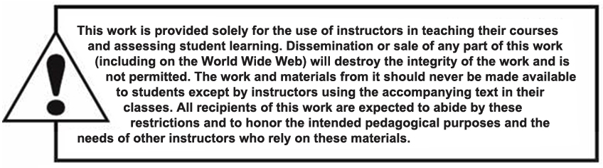
Copyright

